Slide 1
The delivery of Trauma- Informed care within the female prisons in the North of England
Dr Angela Kennedy

Slide 2
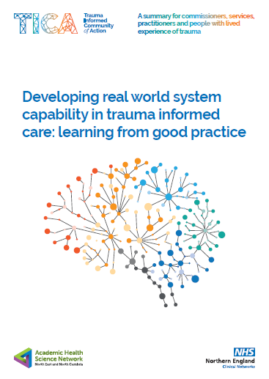
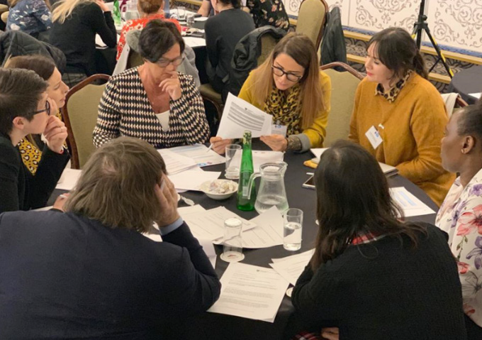
Background to the project

Slide 3
Why are trauma informed approaches to care important
“Putting the people’s lived experience of adversity at the centre of our efforts to create both individual and collective wellbeing by engaging constructively with the complexity of that lived experience”.

Slide 4
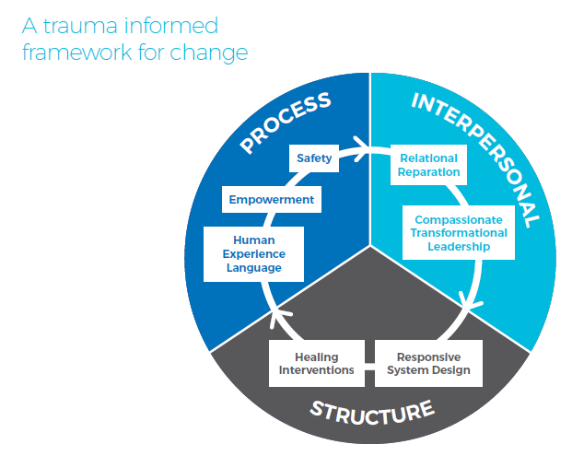
Open Narrative System
Notes:
STUCTURE: the things that services choose to deliver and the way the services are organised and commissioned.
Trauma informed services deliver a range of interventions aimed at healing and growth and are organised collectively to bridge all the needs of the population seamlessly.
PROCESS: the way that services deliver what they do and the language they use to describe things.
Such processes of delivery and engagement need to be focused on addressing power issues and safety (both physical and psychological). It can help to use language that demonstrates that people are understood as reacting to context, allows multiple perspectives and is free enough of jargon that allows more people to join in the conversation.
INTERPERSONAL: the relationships within and between services and with people who engage with services for support.
Trauma informed relationships are based on mutual respect, authenticity, moral courage and empathy. It is not envisioned that disagreements won’t happen but rather they are approached with a motivation to repair damage to relationships in order to promote trust. This implies that leaders need to be appointed and held to account for the way they contribute positively to such a culture.

Slide 5
TiCA Project
A Core Action Group was established and meets monthly with 18 members giving good national representation, lived experience and expertise in a variety of settings.
The Core Action Group oversees:
The Trauma Informed Care workspace on the NHS Futures Platform
Regular webinars
A coaching and mentoring offer
An external evaluation to shape the work
Specific project work eg practice guidance

Slide 6
FutureNHS Platform
The Trauma-informed Community of Action opened a workspace on the Future NHS Collaboration Platform in March 2020 allowing forum discussions and distribution of information. In November 2021, the community had 825 members. The profile of new members is illustrated below.

Slide 7
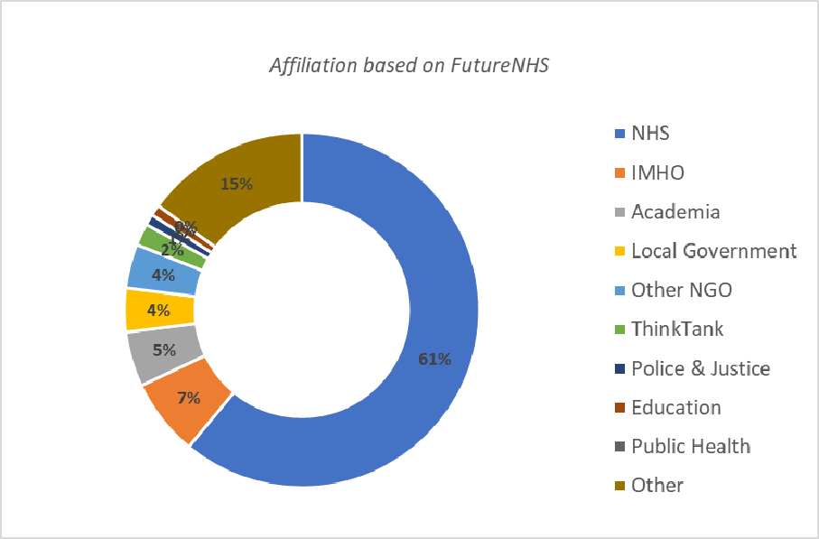
FutureNHS Platform
The profile of members by affiliation shows that while over 60% of members are connected with the NHS, a significant number of members are from elsewhere.

Slide 8
Co-production and lived experience leadership
The TiCA Project prides itself on co-production and can demonstrate active involvement by:
Lived experience representatives as members of the Core Action Group
The CAG being co-chaired by a national recognised expert by experience and senior researcher
All webinars include expert by experience speakers
Some webinars are chaired by individuals with lived experience of using services
The topic of one webinar was best practice in lived experience leadership
The ‘Sensemaker’ evaluation is inherently a method of co production reflecting the complexity of situations and communities which allows expression of differing opinions and is derived from first-hand narratives and experience.
Open narrative enquiry as a rapid method of consensus.
Implementation guides using co-production eg assessments for therapy.

Slide 9
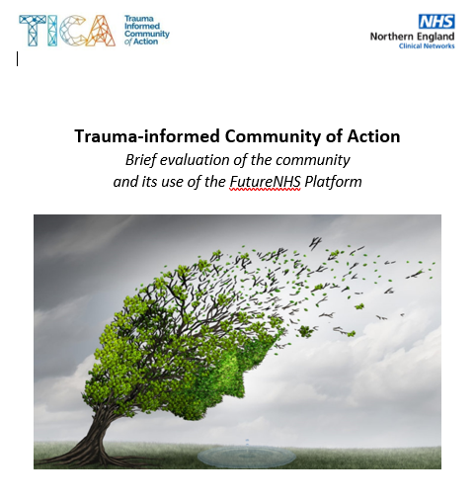

Highlights from a brief evaluation of TiCA
Considering Implementation Barriers & Leadership
The largest and most difficult barrier to the adoption of trauma-informed care is that services are currently too piecemeal for trauma survivors. This was closely followed by service being too medicalised.
The community of action is using all trauma-informed values to promote compassionate leadership.
The strongest indicators of adoption of trauma-informed care are its inclusion in strategic plans, regulations and inspections, and its use in supporting and supervising staff.

Slide 10
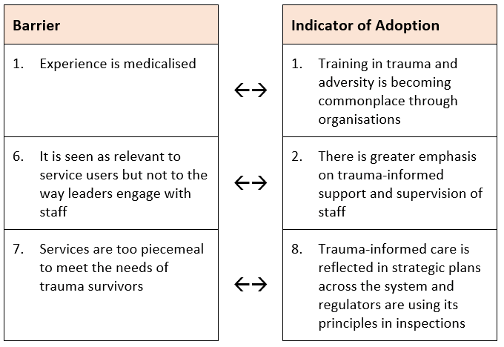
Finding 2: The largest and most difficult barrier to the adoption of trauma-informed care is that services are currently too piecemeal for trauma survivors.
Inferential links between largest/most difficult barriers and indicators identified in Finding 1 as providing most evidence of the adoption of trauma-informed care.

Slide 11

Monitoring the Implementation of Trauma-informed Care
The ROOTS Framework
DOMAINS AND ITEMS
SAFETY
11
TRANSFORMATIONAL LEADERSHIP
8
LANGUAGE
8
SOCIAL
7
WHOLE SYSTEM
6
TRAUMA-SPECIFIC INTERVENTIONS
7
EMPOWERMENT
7
Credibility
HOW WAS IT DEVELOPED?
Step 1
Step 2
Step 3
Literature review and national summit
Trauma-informed Care leads meetings and Delphi study
Focus groups were used to pilot test the framework

Slide 12
Goals of ROOTS
Change in individuals or organisations is rarely linear.
A reflexive approach that evolves over time is of benefit.
There is not a ‘one size fits all’ interpretation of trauma-informed implementation.
Different settings need to define through coproduction what is needed for them.
consensus decision making on practice points,
reflecting on how well it is embedded using actual examples
deciding how to take it forward that Roots uses what we know about complex system change.
It builds shared awareness,
shared motivation and shared goals.
It assimilates multiple narratives.
It deepens individual understanding and networks their efforts to others.

Slide 13
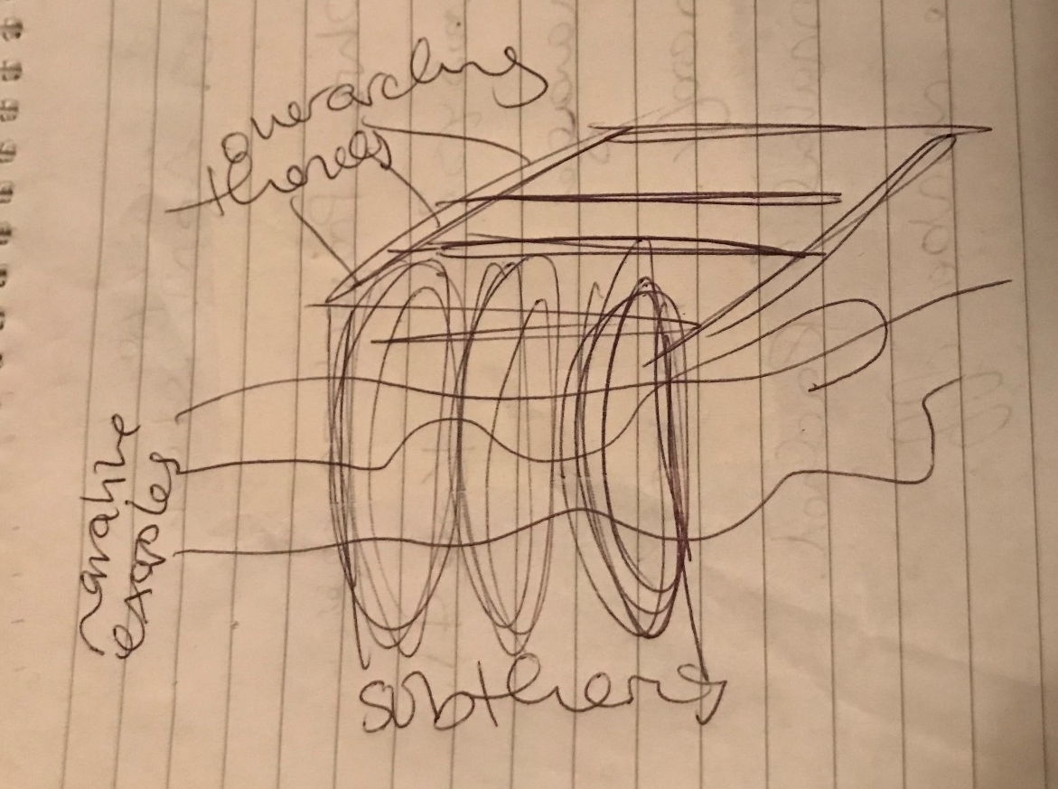
Embracing Complexity…
Lee Walton
Garry Elvin
Petia Sice
Wellbeing Informatics team at the School of Computing and Information Sciences at Northumbria University

Slide 14
An open narrative system is a way of exploring narrative based themes to provoke learning and reflection. The aim is to capture the complexity of change in systems. It uses a 3D structure where routes to exploration can deepen and be individualised. The themes are based on an analysis of real good practice examples and these exist as narratives at the deepest level to illustrate practical application.

Slide 15
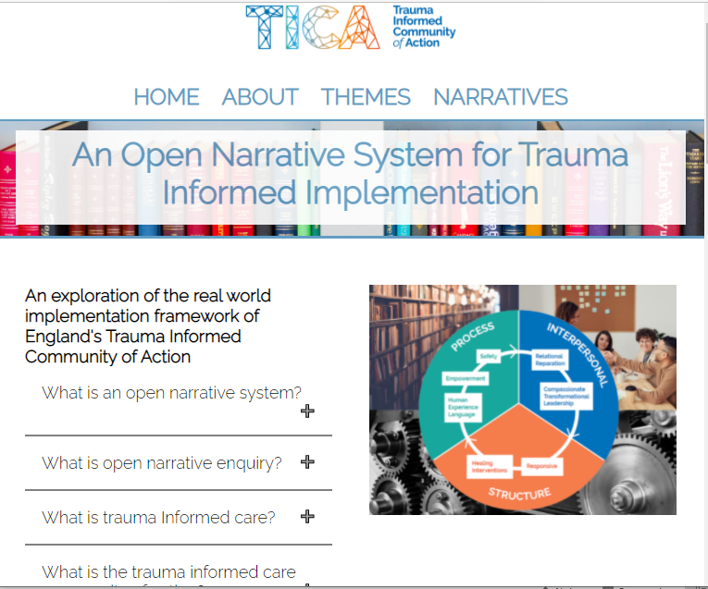
https://opennarrativesystem.co.uk/TICA

Slide 16
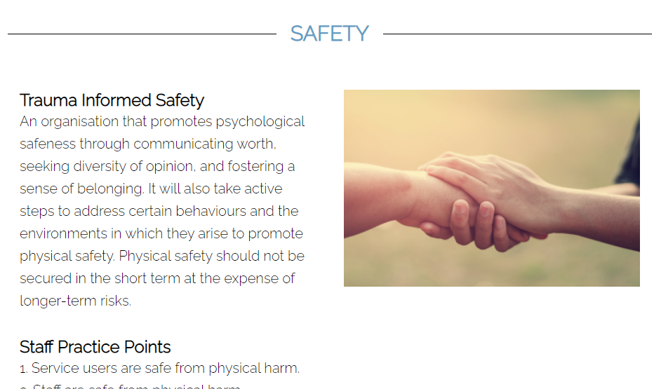
Exploring the subtheme of safety within PROCESS

Slide 17
Staff and service user perspectives on safety
Service user
1. I feel safe from physical harm in this service.
2. staff are safe from physical harm here.
3. Staff see everyone as of worth with valid experience and opinion.
4. Staff understand my personal risks as arising from the consequences of my past or current adverse experiences e.g., abuse, housing, finance etc.
5. The triggers and underlying reasons for my personal risks are addressed
Staff
1. Service users are safe from physical harm.
2. Staff are safe from physical harm.
3. My team/service see’s everyone as of worth with valid experience and opinion.
4. An individual’s risks are understood and formulated in the context of previous experience and trauma.
5. The underlying psychosocial causes of risks are actively addressed.

Slide 18
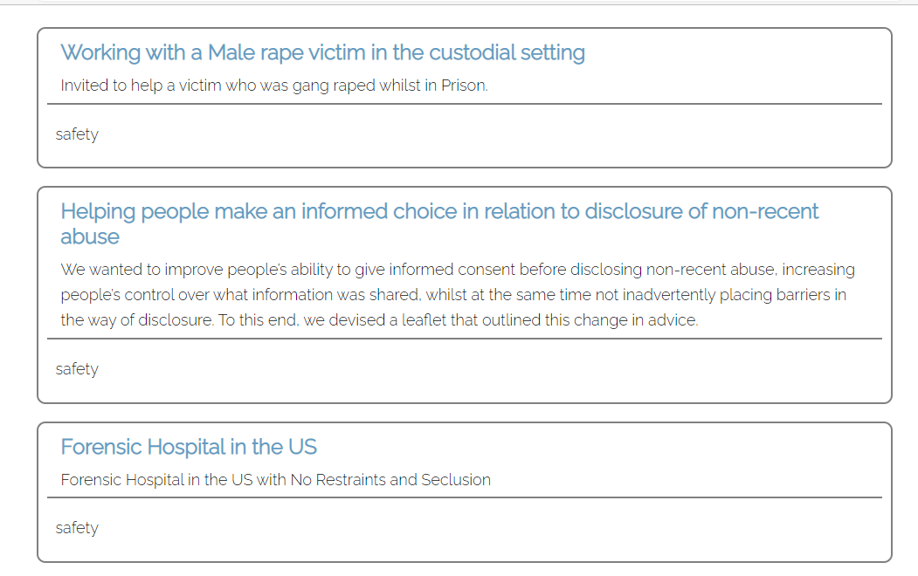
Narratives exemplifying safety

Slide 19
Current project
A directive from the North of England Women’s Prisons Health Partnership Board was to commission a project to scope out the delivery of Trauma- Informed care within the four women’s prisons in the North of England.
NHS England have commissioned the national Trauma Informed Community of Action (TICA) to undertake this project, which has three aims:
Identify and evaluate evidence-based practice within this context, through a review of the literature by a suitably qualified researcher making sure that lived experience is included.
Identify gaps and suitable models. TICA will work with on-site leads to develop a tool that outlines what good might look like and how they can work towards that based on the ROOTS framework.
Produce a report outlining the potential delivery of trauma-informed models care. TICA will work with a suitable expert in this field to summarise the findings in a project report and handover to the commissioners which will be presented to the North of England Women’s Prisons Health Partnership Board.

Slide 20
Objectives
Agree across stakeholders the areas of focus to form the basis of workshops in February 2022.
Co-ordinate system intelligence and resources to inform prevention, intervention, rehabilitation, and recovery pathways .
Public health focus / proactive identification of inequalities; action to collectively address contributory factors to reduce criminal justice contact, support diversion from custody and reduce recidivism risk.
Inform needs led commissioning that fully engages all partners.

Slide 21
Principles
Equal partnership approach; collaboration not competition.
Expert by experience engagement and coproduction from outset.
Aligned with mental health alliance principles and ICS approach.

Slide 22
Groups set up to support this work
Expert Governance Group
Stakeholder Group
Lived Experience led focus groups
Research pairing

Slide 23
Why do we need to consider trauma informed transformation of public services?

Slide 24
policy
Staff wellbeing
Lived experience
Unintended harms
evidence
World view

Slide 25
stats
Agenda’s research shows that 1 in 20 women have a history of extensive physical and sexual violence starting from childhood. 33 Of these women: • over half (54%) have a common mental health condition; • a third (31%) have an alcohol problem; • more than a fifth (22%) have run away from home in childhood; • 8% have spent part of their childhood in care (compared to 1% of women in the general population); and • 4% have been permanently excluded from school.
Between three quarters and 90% of girls in contact with the youth justice system may have experienced abuse from a family member or someone they trusted.
63% of girls and young women (16–24) serving sentences in the community have experienced rape or domestic abuse in their own intimate partner relationships15

Slide 26
Needs analysis
A lack of gender-specific data, reporting and monitoring of outcomes at a national and local level means that the needs of all girls and young women in contact with the criminal justice system have not been comprehensively mapped and understood, limiting the development of effective responses in criminal justice and statutory agencies.

Slide 27
needs
A lack of gender-specific data, reporting and monitoring of outcomes at a national and local level means that the needs of all girls and young women in contact with the criminal justice system have not been comprehensively mapped and understood, limiting the development of effective responses in criminal justice and statutory agencies.

Slide 28
Ten principles for trauma-informed services for women
1. Trauma-informed services recognise the impact of violence and victimisation on
development and coping strategies.
2. Trauma-informed services identify recovery from trauma as a primary goal.
3. Trauma-informed services employ an empowerment model.
4. Trauma-informed services strive to maximize a woman’s choices and control over her
recovery.
5. Trauma-informed services are based in a relational collaboration.
6. Trauma-informed services create an atmosphere that is respectful of survivors’ need for
safety, respect, and acceptance.
7. Trauma-informed services emphasise women’s strengths, highlighting adaptations over
symptoms and resilience over pathology.
8. The goal of trauma-informed services is to minimise the possibilities of retraumatisation.
9. Trauma-informed services strive to be culturally competent and to understand each
woman in the context of her life experiences and cultural background.
10. Trauma-informed agencies solicit consumer input and involve consumers in designing
and evaluating services
(Elliot et al., 2005)

Slide 29
recommendation
In policy and in practice, responses to young women driven into the criminal justice system by violence, abuse and exploitation treat vulnerable young women first and foremost as ‘perpetrators’ of crime, rather than being in need of support. Punished for survival strategies and their response to trauma, young women face a lack of understanding and recognition of their needs. They have limited access to specialist support despite extreme levels of need, and face blame, re-traumatisation and risk of further harm whilst in contact with statutory services. Black and minoritised young women and young women with experience of the care system face greater barriers still in accessing safety and support as overlapping forms of stigma and discrimination put them at greater risk of criminalisation, perpetuating cycles of abuse and inequality. Where specialist, dedicated services for young women are available, young women in contact with the criminal justice system describe this as having a significant, positive impact on their lives. Too often, however, young women experience this kind of intervention as coming too late – when risk has escalated, extensive harm has been done, and young women are at heightened risk of repeated criminal justice involvement. These findings are stark. They underscore the need for age-, gender- and trauma-informed practice to become embedded in statutory provision as a matter of urgency. This must be done alongside meaningful investment in specialist, independent provision to prevent young women being left to navigate the long-term impact of trauma and the stigma of criminalisation as they are just beginning their adult lives.

Slide 30
Gender and trauma-informed principles
(from the Women’s Mental Health Taskforce final report)
• Governance and leadership: There is a whole organisation approach and commitment to
promoting women’s mental health with effective governance and leadership in place to
ensure this.
• Equality of access: Services promote equality of access to good quality treatment and
opportunity for all women, including LBTQ and BAME women.
• Recognise and respond to trauma: Services recognise and respond to the impact of
violence, neglect, abuse and trauma.
• Respectful: Relationships with health and care professionals are built on respect,
compassion and trust.
• Safe: Services provide and build safety for women, creating a safe environment that
does not retraumatise. Services respond swiftly and appropriately to incidents that
put women’s safety at risk, including robust processes for reporting and investigating
sexual abuse and assault.
• Empowerment through coproduction: Services engage with a diverse group of women
who use mental health services to co-design and coproduce services. Services promote
self-esteem, build on women’s strengths and enable women to develop existing and
new capacities and skills.
• Holistic: Services prioritise understanding women’s mental distress in the context of
their lives and experiences, enabling a wide range of presenting issues to be explored
and addressed, including with a focus on future prevention. Services support women in
their role as mothers and carers.
• Effective: Services are effective in responding to the gendered nature of mental distress.
(Department of Health & Social Care, 2018)

Slide 31
Quote
All public service commissioning bodies
should adopt trauma- and genderinformed
commissioning principles for the
services for which they are responsible.
Commissioning frameworks should make
achieving this goal an explicit expectation
of a service when they commission it.
Commissioners must recognise that
developing and delivering traumainformed
approaches can be a significant
undertaking, and should therefore
sufficiently fund the time, resource and
expertise to enable this and allow it to
embed

Slide 32
Challenges for trauma-informed care:
included the difficulty of bringing about a
trauma-informed approach in an inherently
traumatising environment, such as a prison.

Slide 33
Organisational issues:
many organisations
found it challenging to make the sort of
cultural shift needed in order to start
delivering trauma-informed services.
Shifting a paradigm and changing a culture
in this way is a long-term process.

Slide 34
Funding and commissioning:
many of
the services we visited were delivering
trauma-informed approaches under what
was frequently described as precarious or
“fragile” funding conditions, often through
a number of different funding streams –
creating challenges to delivering holistic
support.

Slide 35
Approaches to service delivery:
the services
that seemed best able to adopt traumainformed
approaches tended to have a
holistic approach to meeting women’s
needs; to prioritise relationships and peer
support; and to create a sense of safety,
choice and control

Slide 36

Facing a dark reality….
Notes:
WHAT IS TRAUMA
Events which provoke fear or pain
Events which provoke loss
Events that exclude us from others
Relationships which inflict harm on others
Absence of care or neglect
Witnessing the above

Slide 37
Events which provoke fear or pain
Events which provoke loss
Events that exclude us from others
Relationships which inflict harm on others
Things that challenge out sense of reality
Absence of care or neglect
Witnessing the above
Notes:
WHAT IS TRAUMA
Events which provoke fear or pain
Events which provoke loss
Events that exclude us from others
Relationships which inflict harm on others
Absence of care or neglect
Witnessing the above

Slide 38
What are trauma informed approaches?
“They are based on a recognition and comprehensive understanding of the widespread prevalence and effects of trauma. This leads to a fundamental paradigm shift from thinking ‘What is wrong with you?’ to considering ‘What happened to you?’ Rather than being a specific service or set of rules, trauma-informed approaches are a process of organisational change aiming to create environments and relationships that promote recovery and prevent retraumatisation”
Relationships in trauma-informed mental health services by Angela Sweeney, Beth Filson, Angela Kennedy, Lucie Collinson & Steve GillardBJPsych Advances (2018), vol. 24, 319–333 doi: 10.1192/bja.2018.29

Slide 39
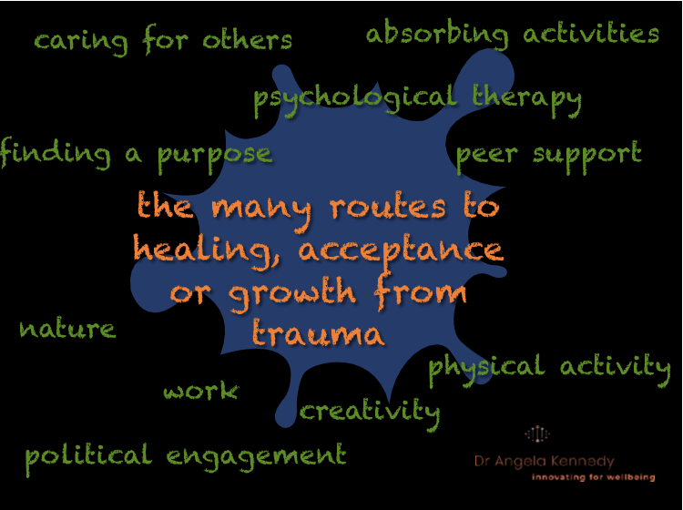

Slide 40
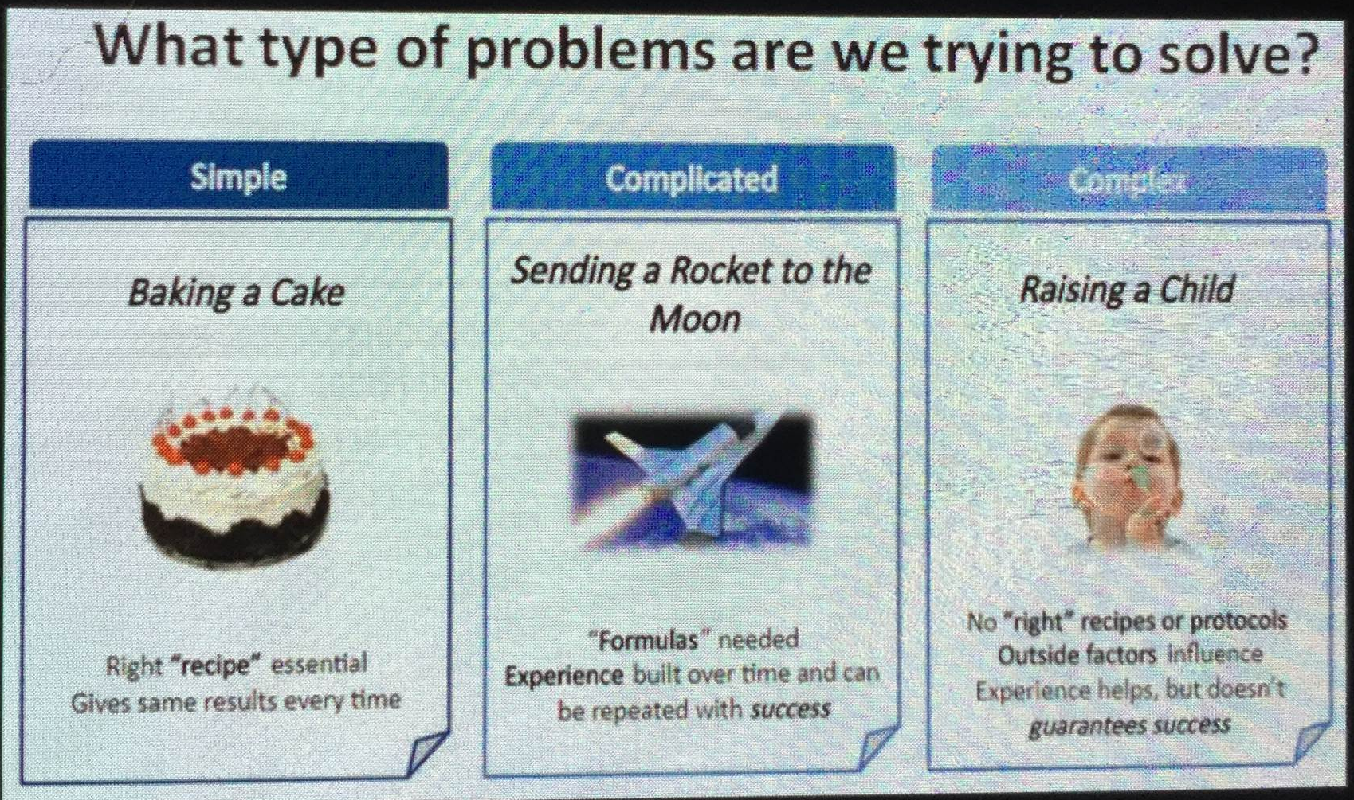

Slide 41
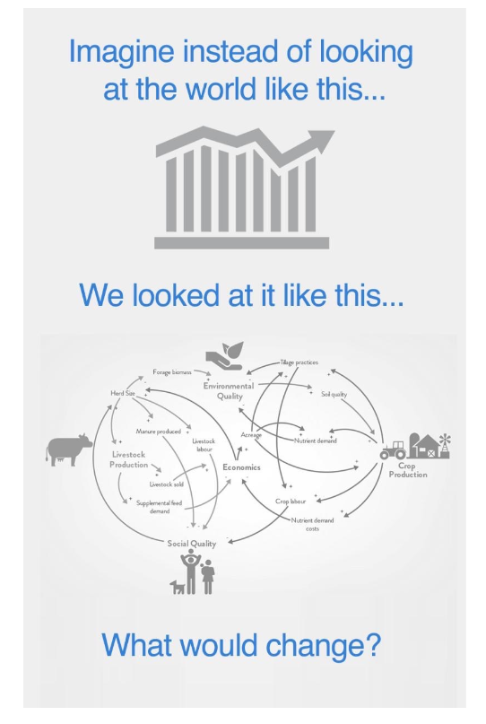
Infographic from System Innovation

Slide 42
Ladder of engagement and style of leadership
devolve
Do for (engage)
Do to (experts know best)
Do with (co-produce)

Slide 43
Areas of Focus
What Data and Intelligence do you have that you can share?
What are your current Access/ Models/ Pathways of Care and what could be different?
What resources/ skills might staff need?
Staff Wellbeing needs protected: what helps?

Slide 44
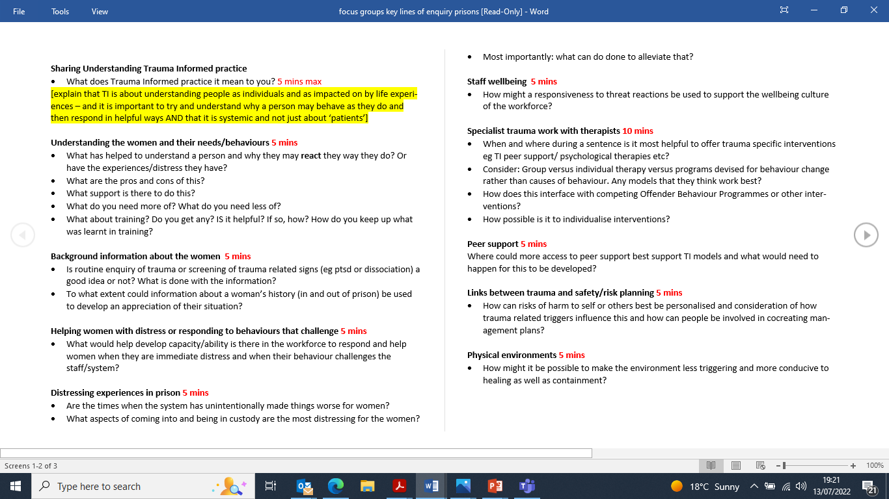
Key lines of enquiry in focus groups

Slide 45
Activity
task | Jan | Feb | March | April | May | June
Scoping/ Planning
Evidence Review
Governance Meetings
Stakeholder Engagement
Focus Groups
Expert Reference Group
Collating Report
Final Debrief with Experts by Experience Group
Final report submitted

Slide 46
Evidence Review Recommendations
Trauma-informed care (TIC) and trauma specific (TS) interventions should be based in the community.
In-prison support should not be implemented in a way that inadvertently incentivises up tariffing or increased custodial sentences. No woman should be sent to prison for treatment due to a lack of appropriate community-based TIC.
Where TIC is implemented in prisons, this necessitates a holistic approach with buy-in from senior management and officers. It involves a whole prison approach; one-off training is not sufficient.
Some trauma-informed and trauma specific work is required to meet the needs of the small number of women serving IPP or long sentences
Assessments need to be made on an individual prison basis to reflect on the risks and benefits of implementing TIC and the possibility of causing inadvertent harm.
There needs to be routine screening for traumatic head injury of all women. Trauma specific interventions adapted to meet the needs of these women should be considered.
Specific healthcare pathways can be improved by taking a trauma-informed approach. There is evidence of good practice already for a trauma-informed perinatal pathway; this should be implemented.

Slide 47
Evidence Review Recommendations Continued
Traumatised women must not be given or considered to meet the criteria for personality disorder in order to access TIC/TS care.
No woman should be forced to take part in a trauma-based intervention as part of a sentence plan. Consent is of paramount importance.
Consider implementing TIC approaches and interventions that centre the context of distress, rather than individual pathology.
Apart from some therapeutic communities, the prison environment is not in general conducive to trauma-informed work.
Co-production is key to TIC. This includes people with lived experience leading on designing and delivering training, and co-producing outcome measures to assess whether TIC/TS interventions have been successful.

Slide 48
Emergent themes
peers
staff wellbeing
disclosures
interventions
crises
environment

Slide 49
Peers
In training
In support
In crisis
In leadership
Advocates
Mentored
Governed
External

Slide 50
Staff wellbeing
Independent
Wellbeing oriented
Schwartz
Postvention
Screening for ptsd

Slide 51
disclosure
No routine enquiry on entry
Consent for info to follow
Screening for symptoms instead
Compassionate listening
Referral on release

Slide 52
crises
Framing within context rather than always disorder or personality or past trauma
Support offered early
Support not dependent on crisis
Safety planning
Interventions for immediate distress
Mindful of impact of witnessing this on others

Slide 53
interventions
Not dependent on diagnosis
Not pathway driven
Needs led and personalised
Trauma specific work primarily after discharge
Diversion where possible
Open access and not mandatory
Different options for long term prisoners
Range of therapies including body work
Activities available including training and self development

Slide 54
environment
Staffing
Leadership
Qualifications and governance
Buildings
Reception
Quiet space
Adequate therapy rooms

Slide 55
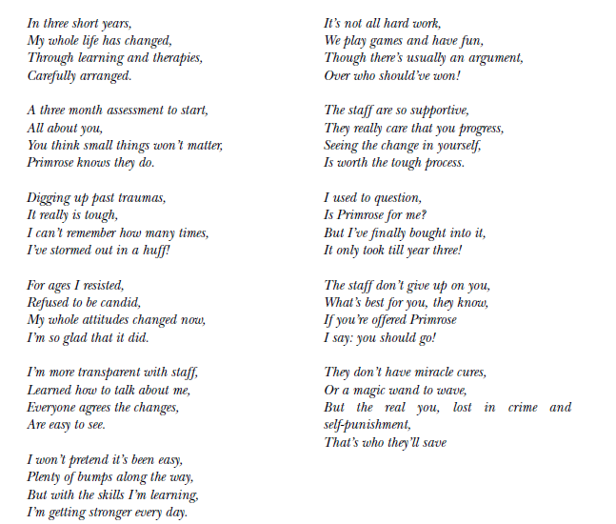

Slide 56
acknowledgements
Dr David Harvey, Clinical Director, Consultant Clinical Psychologist and Cognitive Analytic Therapist – Collaborative Planning and Quality Team (CPaQT), Humber Coast and Vale Provider Collaborative and Humber Teaching NHS Foundation Trust
Darren Archer, Network Manager (Mental Health) – Northern England Clinical Networks
Jo Lomani, Senior Project Manager, Expert by Experience, Provider Collaboratives Programme – NHS England and NHS Improvement
Dr Charlie Brooker, Honorary Professor – Royal Holloway University of London
Divya Dinraj, Project Manager - Mental Health Programmes – Academic Health Science Network North East and North Cumbria (AHSN NENC)
Peter Jones, Chair – Counselling in Prisons Network (CIPN)
Alyce-Ellen Barber, NHSE Health & Justice Lived Experience Network Chair
Zoe Deith, Programme Facilitator, CRC
Amina Ditta, Peer Support Team Co-ordinator, Liaison and Diversion Service, South Yorkshire Partnership Foundation Trust

Slide 57
contacts
Please send participants for focus groups to divya.dinraj@ahsn-nenc.org.uk
Thanks
Angela.kennedy@cntw.nhs.uk

