Slide 1
Leave No One Behind
Professor Jo Peden DrPH, MSc, FFPH
Consultant in Public Health
jo.peden@wales.nhs.uk
@jo_peden
Leave No One Behind
Notes:
Improving health of women in prison
Preventing offending and intergenerational effects
Addressing health inequalities – most deprived have worst health outcomes

Slide 2
Notes:
How are we doing?

Slide 3
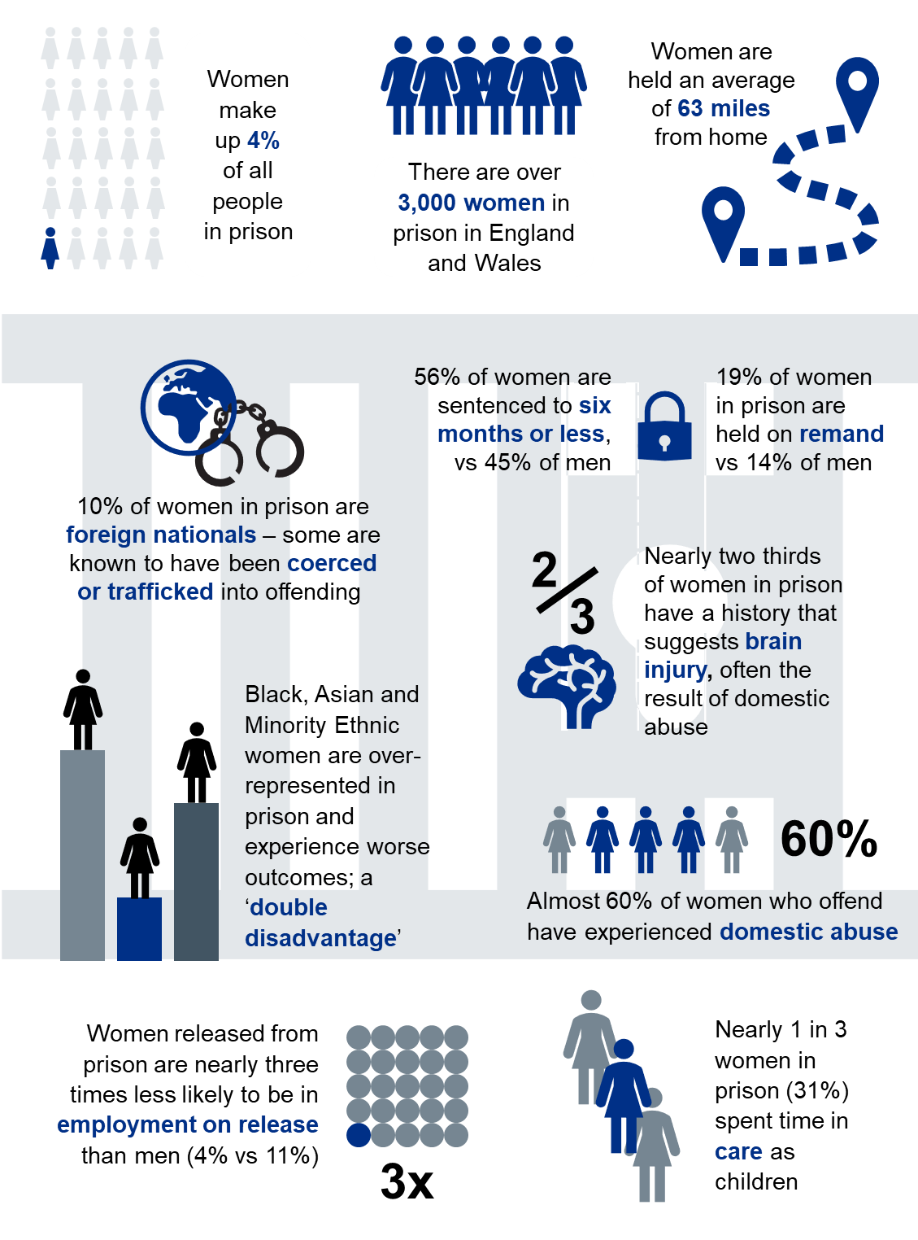
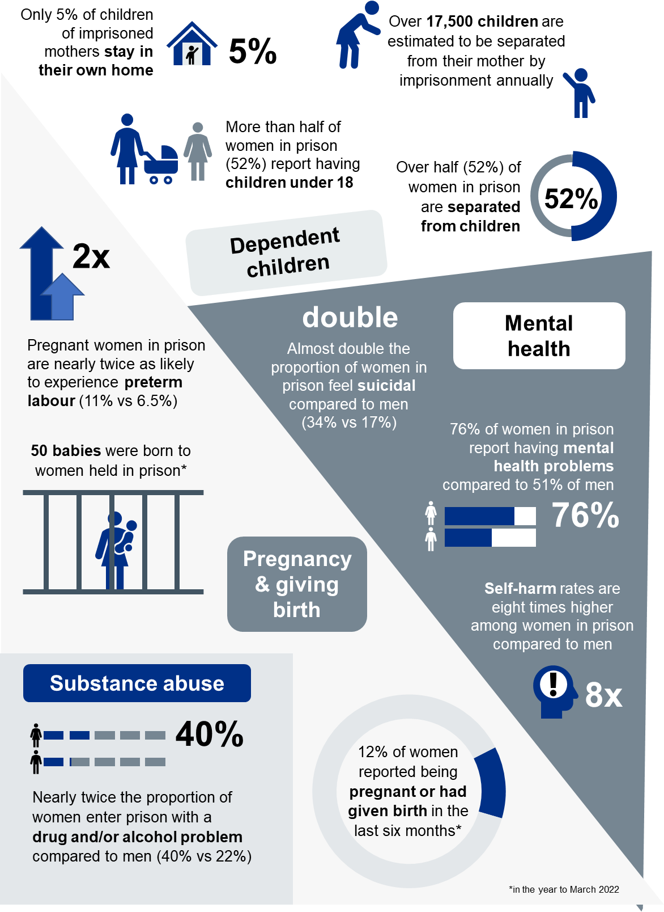
Profile of women in prison

Slide 4
Protecting and improving the nation’s health
Gender Specific Standards to Improve Health and Wellbeing for Women in Prison in England

Slide 5
A review of health and social care in women’s prisons
It is vital that we utilise the power of lived experience voices to their fullest potential. Hearing form women with lived experience about how services can better meet their needs and build on their strengths, is likely to be more effective and efficient than services designed without their unique insight. This review groups has lived experience throughout, from the voices of women in the prison estate, through to the Board. This is an exceptional example of how to involve experts by experience, ensuring impressive outcomes for all
- Board member with lived experience
Leave No One Behind
Notes:
Importance of lived experience to improve health services in prison

Slide 6
Quote from woman in prison
“As women have had bad experiences with men - domestic violence, rape and do not trust men at all, I need some help with this, though nothing is available, I never met a counsellor or a therapist in prison. Women that have been victims of domestic abuse, abused, lost their children, and there is nothing in place for them like therapy. There should be safe spaces where they can open up, either group therapies or 121 sessions, or alternatives to help us get it out – writing, art, or gardening – there is nothing like this in prison – those small things that help us feel better.”
Notes:
Overview of review

Slide 7
Risk Factors for Offending
Risk factors
Race and ethnicity
Learning disability and neurodiversity
Mental illness and substance misuse
Traumatic brain injury
Domestic Abuse
Poverty
ACE’s
Notes:
PHW Pathways to Offending – Lit review identified key risk factors/ primary prevention

Slide 8
Adverse childhood experiences Traumatic events that can have negative, lasting effects on health and well-being
Neglect
Emotional neglect
Physical neglect
Household challenges
Domestic violence
Parental separation/ divorce
Substance abuse
Mental illness
Incarcerated parent
of the population have at least 1 ACE
67%
Abuse
Emotional abuse
Physical abuse
Sexual abuse
1/8 of the population have more than 4 ACEs
Early death
Disease, disability, social problems
Adoption of health-risk behaviours
Social, emotional, cognitive impairment
Disrupted neurodevelopment
Adverse childhood experiences
Lifespan
Adverse childhood experiences are the single greatest unaddressed public health threat facing our nation today
Dr Robert Block, the former President of the American Academy of Pediatrics
People with 6+ ACEs can die
20 years
earlier than those who have none
Notes:
How do we prevent women going to prison in first pla

Slide 9
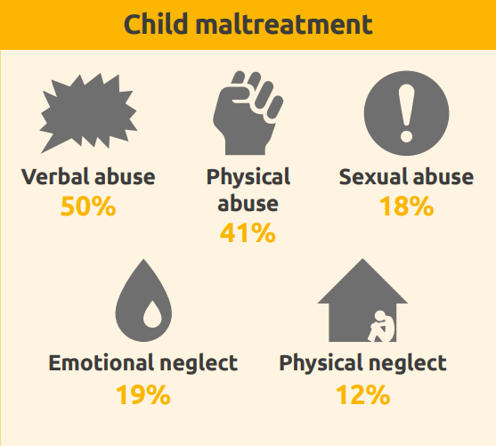
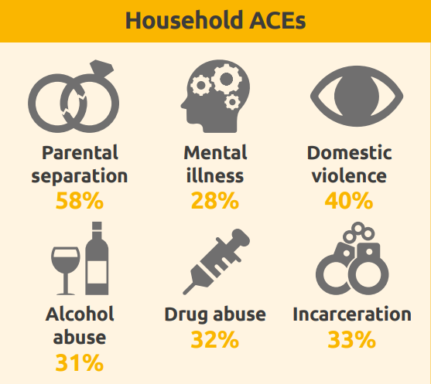
Adverse childhood experiences (ACEs) in an offender population in Wales
The Prisoner ACE Survey interviewed 468 adults (aged 18-69) in a Welsh prison between February and June 2018. Participants were asked about their exposure to 11 ACEs in childhood, their offending history and recent involvement in violence.
How many prisoners reported each ACE?
Notes:
High verbal abuse/ physical abuse / domestic abuse

Slide 10
Over 8 in 10 prisoners reported at least 1 ACE, and nearly half had 4 or more ACEs
Prisoners with 4 or more ACEs were 4 times more likely to have ever served
a sentence in a young offender institution (YOI) than those with no ACEs
Of the 46% of prisoners who had ever served a sentence in a YOI:
Notes:
46% of prisoners had 4 ACE’s or more

Slide 11
ACE count prevalence measured in the Welsh male general population (2017 Welsh ACE and Resilience Study) and the 2018 Prisoner ACE Survey
Notes:
12 % 4 or more ACEs 46% in prisoners

Slide 12
Life course: Points of intervention
Encouraging a healthy pregnancy: support to mother for good nutrition, breastfeeding, access to substance misuse and mental health services
Screening for acute brain injury and behavioural difficulties, ACE-informed school environments, preventative action for school exclusions
Support to young adults, NEETs and children leaving care, training opportunities, support to help children with multiple health needs to coordinate access to services
Pre-conception
Pregnancy
Early years
Primary school
Secondary school
18+
16+
Fit for pregnancy
Healthy Child Programme, ready to learn interventions to promote school readiness, health visiting, wrap-around support for high risk families, early identification of communication and behavioural difficulties
Action to support pupils at risk of exclusion, promotion of life building skills, sports and extracurricular activities, whole-school promotion of good mental health
Support to CYP transitioning from children’s secure settings to adult prisons
At-risk transition points – opportunities for intervention
Leave No One Behind

Slide 13
Creating Resilient Children
“A resilient child is one who bounces back from adversity and continues to function reasonably well, despite continued exposure to risk” Gilligan, 1997
Factors that promote resilience in all phases of the lifecycle:
Self-esteem and self confidence
Sense of self-efficacy/belief in ability to affect their own lives
A range of social, problem-solving approaches
The presence of at least one unconditionally supportive parent or trusted adult
External support system - a committed mentor or other person from outside the family
Participation in a range of extra-curricular activities
The ability or opportunity to "make a difference" by helping others or through part time work
Leave No One Behind
Notes:
Can’t remove stress help build resilience – trusted adults/ build self confidence/ life opportunites
https://www.jrf.org.uk/sites/default/files/jrf/migrated/files/parenting-resilience-children.pdf
Those with most advsersity most likely to have least support to build adversity
LH comment – is there evidence about the impact of engaging in physical activity?
Those who are resilient do well despite adversity, although it does not imply that those who are resilient are unharmed – they often have poorer outcomes than those who have low-risk background but less resilience. This applies to health outcomes and effects success in a range of areas of life across the life course. Evidence shows that resilience could contribute to healthy behaviours, higher qualifications and skills, better employment, better mental wellbeing, and a quicker or more successful recovery from illness.
Resilience is not an innate feature of some people’s personalities. Resilience and adversity are distributed unequally across the population, and are related to broader socio-economic inequalities which have common causes – the inequities in power, money and resources that shape the conditions in which people live and their opportunities, experiences and relationships.
Those who face the most adversity are least likely to have the resources necessary to build resilience. This ‘double burden’ means that inequalities in resilience are likely to contribute to health inequalities.

Slide 14
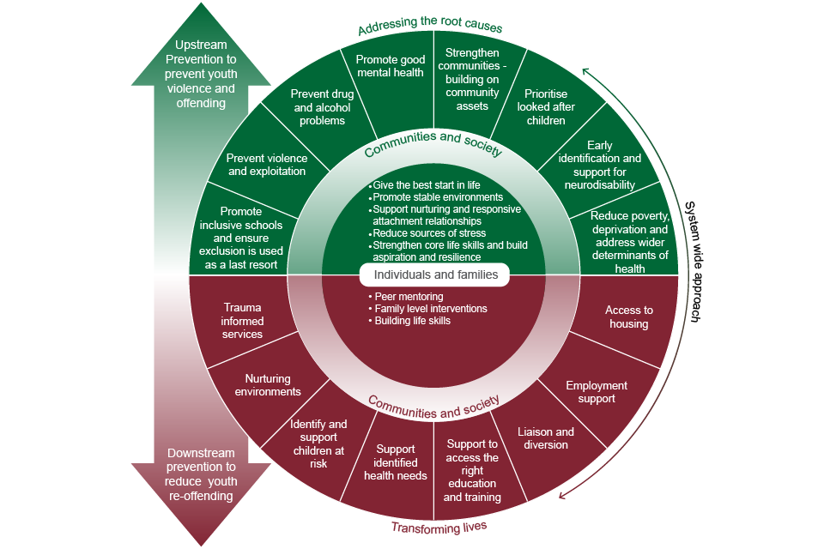
Joining up the action
Leave No One Behind

Slide 15
Whole systems approach
Clearly articulated vision
Distributed leadership
Creating the right environment
Place based approach
Collaborative approach
Map and understand the system
Systems thinking
Asset based approach
A whole system approach

Slide 16
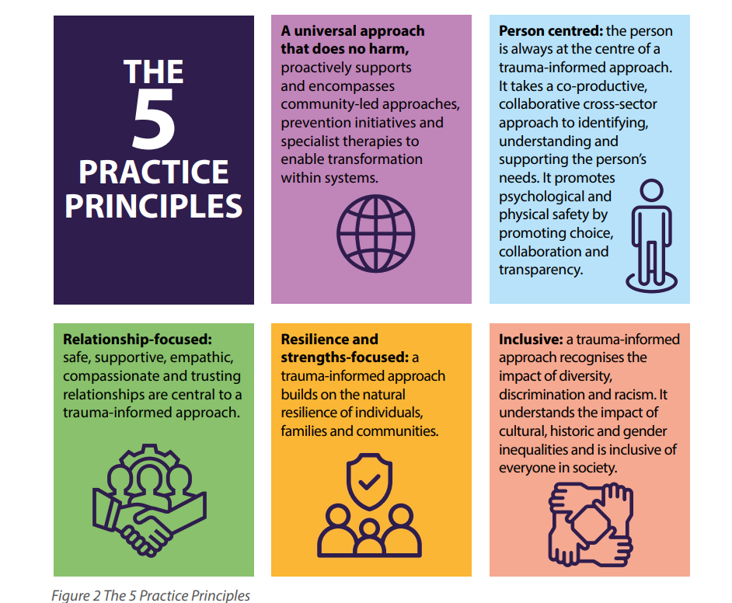
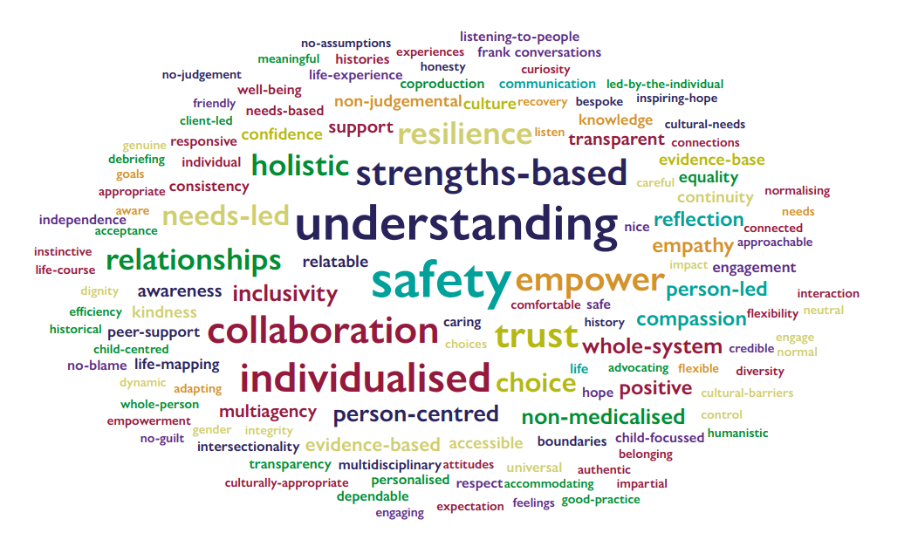
Trauma Informed Wales Framework
Notes:
What action can you take to shift toward prevention

Slide 17
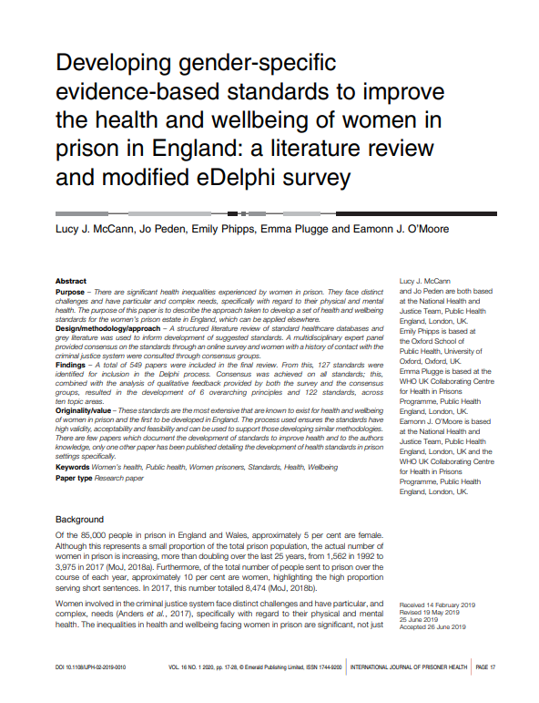
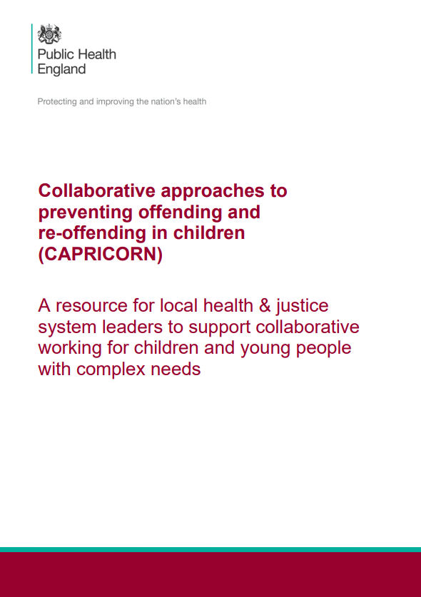
Resources
Leave No One Behind

