Slide 1
Dr Angela Kennedy
Successes and struggles keeping trauma in mind:
Development of a trauma informed adult mental health service

Slide 2

Population: 1,800,000
Employees: 6,500
Turnover: £300million

Slide 3
Aim of trauma informed mental health services services
The primary task of effective services that care for patients with a traumatic base to their mental health issue is to provide a compassionate response that acknowledges the possibility of psycho-social factors in the development of their condition and appreciates some of their symptoms as survival mechanisms

Slide 4
drivers
2008 national data set’s mandatory abuse question
Has there ever been a time in your life when you experienced physical, sexual or emotional abuse?

Slide 5
drivers
CQC safety indicator in their Key Lines of Enquiry:
'Are there reliable systems, processes and practices in place to keep people safe and safeguarded from abuse'?

Slide 6
drivers
NICE Guidance (where trauma is expected to be addressed in a range of disorders, eg schizophrenia)
National Sexual Abuse Inquiry which challenges public services to respond more effectively to abuse survivors
Future in Mind (DoH 2015) which looks at resilience building in children’s services.

Slide 7
Policy in development
DoH and MoJ
announced the development of a national Centre of Expertise in tackling child abuse, and what is being heralded as a “coherent long term strategy” to help victims of abuse.

Slide 8
Optimise
Reduce
Eliminate
Value
Necessary but
non-value adding
Waste
Value creating activities
Non value creating
Waste
Any activity that takes materials or information and converts or transforms them in a way that meets customers’ needs.
Any activity that is needed due to the systems or processes in use today but that does not contribute any value to the product or service or to customer satisfaction.
Activities, processes, time, materials, space, etc., that do not increase the value of the product or service and that are not needed for the system or process.

Slide 9
Outcomes: long term client with regular admissions
Cessation of hospital admissions
No drug abuse
Controlled drinking
Rare self harm
Feelings of love , anger, forgiveness
Assertive at home
Most medication on prn

Slide 10
Pathways aim to have…
Agreed standard of care
The right people
Doing the right things
In the right order
At the right time
In the right place
To the right people
With the right outcome
All with the attention on the user experience
……. And to compare planned with actual

Slide 11

Pathways
– Main Need/ Diagnostic pathway based on NICE guidance
Trauma
Clinical Link
pathway
other
Clinical Link
Pathway

Slide 12
Trauma definition not limited to threats to life! Include attachment:
A response to a discreet or prolonged circumstance which at some point is perceived by the person to be an uncontrollable serious threat to physical or psychological integrity and which at some point overwhelms emotional resources.

Slide 13
The 42 page pathway document contains the following information:-
Introduction
Aims and objectives
A defined scope
The national and local context
The evidence base of the pathway
The model of care and service delivery
The organisational algorithm
Clinical path algorithm
Agreed governance arrangements
Bibliography
Copies of the clinical path document/s

Slide 14
optimism levels 2004-2014

Slide 15
Routine enquiry re trauma and adversity?
disclosure of abuse
or trauma?
yes
currently safe from
harm from others?
no
yes
no
symptom focused
work.
no
engage to facilitate protection
Trauma related condition?
yes
no
yes
no
stabilisation based recovery work.
Recovery?
trauma specific
work.
recovery?
no
yes
yes
discharge from services

Slide 16
Screening Guidance
TEWV Trauma Leaflet ……………………………………………………………………..
Department of Health Guidance ………………………………………………………….
How to Contextualise Trauma …………………………………………………...……….
Considerations when Dealing with Disclosure …….……………………………………
Best Ways to React to Disclosure ………………………………………………………..
Common Reactions to Disclosure and More Helpful Responses …………………….

Slide 17
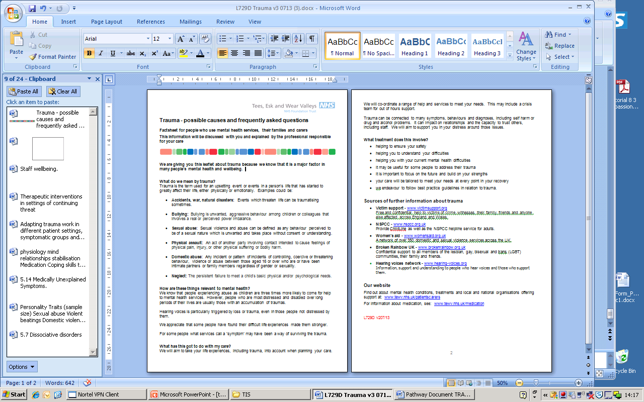

Slide 18
Assessment Guidance
Trauma Screening Questionnaire
Dissociative Experiences Scale
Formulation
A Compassion Focused Formulation of Traumatic reactions
Diagnosis
Care Planning
Trauma Myths

Slide 19
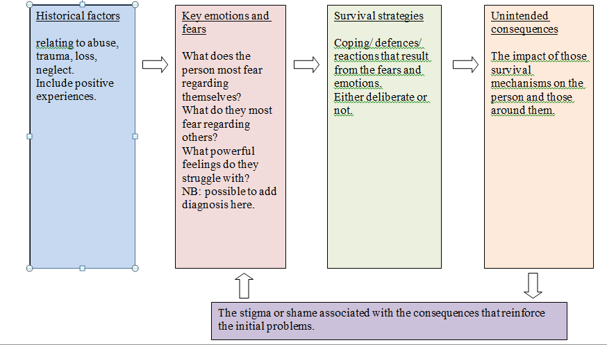
Compassionate formulation of trauma related survival mechanisms

Slide 20
How do I get the person to engage?
Deliver services in a way that avoids unintentional harm or retraumatisation (Fallot and Harris, 2009)
Allow the person as much control and choice as possible and help them review such choices (Markoff et al., 2005).
Engage with the risky states of mind (Brand and Lowenstein, 2014).

Slide 21
Basic Psycho-Education
Brain Leaflet
Threat Defences
Tracking Reactions
Dissociation
Hearing Voices .
Breaking Free
Attachment, Relationships and Trauma
Managing flashbacks

Slide 22
EDUCATION
SUPPORTIVE RELATIONSHIPS
BUILDING A LIFE WORTH LIVING
LEARNING TO MANAGE STRONG EMOTIONS

Slide 23
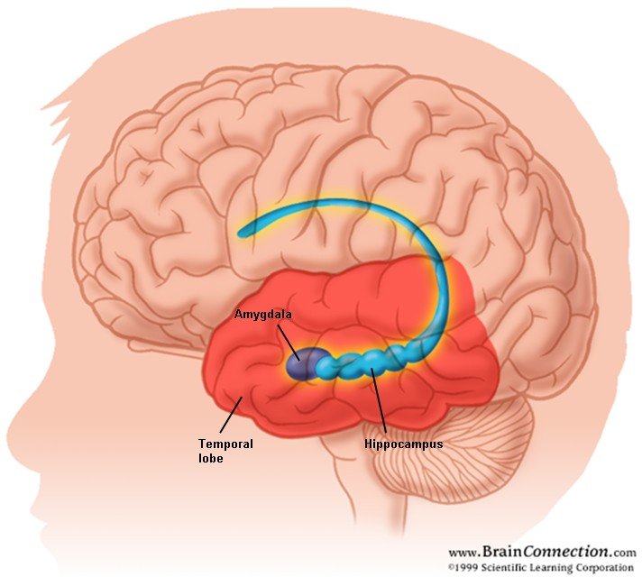

Slide 24
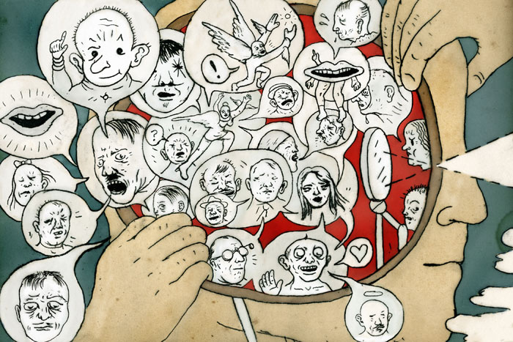

Slide 25
A Therapeutic Framework for Recovery
Principles of Service
A Phased Model of recovery
Skills and Strategies for Working with trauma
‘Five Gold Threads’ – Trauma Focused Work
False Memories
Ethical Issues
Addressing Dissociation
Mindfulness and Grounding Strategies
Mindfulness Exercises
Grounding Box
Working with Dissociative Separation
Dealing with Disintegration of Mind
Therapeutic Relationship Issues
Relationship Dyads Following Trauma
Building a Positive Therapeutic Relationship
Adapting Diagnostic Pathways
Good Practice Tips

Slide 26
Staff Well-being
…….……………………………………………………………………..

Slide 27
Phased Therapy Model
stabilisation
trauma focused work
consolidation
session
duration
therapy duration

Slide 28
 | physiology | mind | relationships
stabilisation | Medication Coping skills training Relaxation training Safe place imagework Pacing sessions Emotional intelligence Self care skills Grounding strategies Soothing strategies Compassionate mind training Resource installation with EMDR Affect management skills | Meditation Psychoeducation Formulations Cognitive restructuring Activity based interventions Esteem work Mapping internal world Mindfulness Adjustment to loss Acceptance Internalisation of containment Behavioural experiments Hopeful goal setting Socratic questions | Supportive interpretations Systemic family work Behavioural family work Social opportunities Working with therapeutic relationship Clear boundaries Assertiveness training Empathic attunement Self help groups Voice dialogue

Slide 29
Trauma focused | Exposure to memory of trauma. Behavioural experiments Behavioural activation Counter-conditioning Learning to have wise threat system Mourning Desensitisation | Free association Insight into relational themes Narrative approaches Cognitive restructuring Creative therapies Schema work Imagery re-scripting Exposure Desensitisation Bilateral stimulation | Round table technique Voice dialogue Working through transference Exploratory interpretations

Slide 30
consolidation | Internalisation of positive experiences | Radical acceptance Cognitive restructuring Mindfulness Goal setting | Social skills training Social opportunities Work opportunities Family work Interpersonal groupwork

Slide 31
Role | Main responsibility
Pathway Lead (Angela Kennedy) | Direction, resources and support
Lead trainer | Promotion with teams and team leads, offer training and follow up teams regularly
Expert by experience | Contribute to training and advise re service user needs
Co-facilitator | Local trauma expertise available to support others in aspects of trauma informed care
Team manager | Keep trauma on team agenda, ensure supervision and formulation happen and prioritise trauma interventions if indicated
Local champion | Interested in promoting trauma related good practice
Clinical team member | Attend training, talk to patients when appropriate re trauma and plan care in line with client needs
Sponsor and Senior Clinical Director | Governance via SDG

Slide 32
Evidence for success
Initial training evaluation n>300
Personal impact on patients
Focus group of staff team
Reduction in meds
Control and restraint stats
DoH stats re routine enquiry

Slide 33
Ward data: 42 patients in 4 months
100% of admissions asked re trauma.
76% report trauma as an issue for them.
Evidence that linked to care planning.

Slide 34
Service User and Carer involvement

Slide 40

From patients
“Brave enough to tackle issues that others were too afraid to acknowledge.”
“at last I felt that I had a framework to understand myself”

Slide 41
“I believe it lets them talk about anything that they consider a trauma which I think is good, cos trauma is different to different people. In the past it would just be a historical piece of information and it would just be parked, whilst we dealt with depression and anxiety and then got them out of hospital but now it’s a major part of the entire intervention and everyone’s aligned around it .... it’s everybody’s business”

Slide 42
“Some of the interventions are so simple but have such an impact on patients and actually we would be spending that time so for some of them it’s not that more time consuming it’s just using your time differently”

Slide 43
“I am glad I have been part of this pilot cos I didn’t realise we didn’t deal with it here”

Slide 44
“Instead of just sitting or having the conversation they are actually doing something this is a therapeutic interaction it’s not just a chat about something, but I didn’t see it before because you feel as if you had achieved something, more meaningful “

Slide 45
“ One of the interventions is from my point of view less medication, less than intervention because there’s more of other things going on and I am confident that there, I mean there is less pressure from the patient, less pressure from staff to prescribe sedatives, medication”

Slide 46
“you’ve got a lot more clear definition and direction….. maybe before it was there as a narrative but we are making more links about how its having an impact”

Slide 47
Reductions in prn lorazepam haloperidol and zopiclone

Slide 48
Brooker et al in press
TEWV =77% compared to national average of 58%

Slide 49
Comparison between TEWV and national experts by experience
Listen…
Validate….

Slide 50
Barriers to pilot
Data collection stalled or unpopular.
Other transformation work taking priority.
Staff feel they do this enough already.
Staff dislike forms but clear changes in attitudes and behaviours.
Want it to be easy.

Slide 51
Supporting implementation
Clearly defined roles.
Give nursing clear leadership roles as they are the main profession who need to own this.
Team readiness and solution focused support from steering group during implementation.
Develop trauma therapists in every locality.
Maintain supervision groups.
Training for champions.
Involvement of experts by experience and charities.
Development of practice guidelines.

Slide 52
What engages staff
Don’t add to their burden
Empower and skill them
Keep on team business meetings agenda and supervision agenda via management support
Joint assessments and complex case consultation.

Slide 53
TIC will enable us to:
Meet DoH guidance re routine enquiry and handle such disclosures well
Clinically address underlying contributory factor to diagnosis/ symptoms/ engagement issues/ risks: better outcomes
For care plans and risk assessments to adequately reflect recovery from trauma as a goal of services
For services to avoid causing iatrogenic harm eg C&R.
Support the development of good practice and research.

Slide 54
Acknowledgments and thanks
Service users who have shown me a path.
ESTD.
KPO team.
Shani Kitchen and Symon Day.
TEWV staff and clinical directors.

Slide 55
Twitter @angelakennedy67
Email angela.kennedy@6nhs.net

