Slide 1
Health and the justice system : European and national issues
Seamus Watson, National Programme Manager, Public Health England
WHO (European Region)
Collaborating Centre - Health in Prisons Programme
Notes:
Thank you for invitation
Plan to describe some of the challenges facing prisoners and prison systems in European region
Will make some remarks about the US prison system along the way but main focus is Europe – 47 Council of Europe Member States & 6 other member states

Slide 2
Prisoners are the community. They come from the community, they return to it. Protection of prisoners is protection of our communities.
Joint United Nations Programme on HIV/AIDS (UNAIDS) Statement on HIV/AIDS in Prisons
Notes:
Prisoners come from society – they spend relatively short periods in prison.
This is sometime double edged – not enough time to undertake effective healthcare interventions and good that they are in not in too long given some of the healthcare challenges present
Could have used the famous Churchill quote “The mood and temper of the public in regard to the treatment of crime and criminals is one of the most unfailing tests of the civilization of any country.”
But this is sufficient reminder that prisoners belong to society and will return there. How well we look after them is a test of sorts.

Slide 3
Responsibility for prison health in Europe?
Currently, either the Justice Ministry or the Interior Ministry is responsible for prison health in the vast majority of Member States of the WHO European Region
In recent years several Member States have transferred the responsibility for prison health to their Health Ministries
- Norway, Sweden, France, UK and Italy
Some Swiss cantons and 2 autonomous regions of Spain have implemented a similar reform
Source :UNODC-WHO Europe
Notes:
Who has responsibility for prison health in Europe?
This is one of the key aims of the WHO programme – to move the responsibility to Health Ministries

Slide 4
Source :WHO Europe
Notes:
Depiction of who is responsible across Europe

Slide 5
Prisoners in Europe
About 2 million in WHO European Member States
6 million people are incarcerated during a given year in Europe
Isolated from public health
Large number of prisoners with drug-related or mental health problem
Source for spread of communicable diseases
Notes:
Large number of people are imprisoned across Europe – more in the USA
Prison populations are growing year on year.
The point of prisons being islands, isolated from public is important
The are also harbours for communicable and non- communicable disease

Slide 6
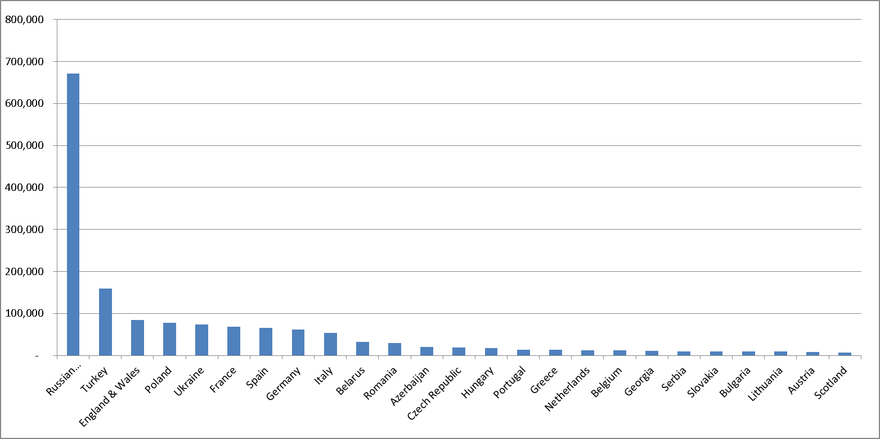
Prison populations
(ICPS 2015)
Notes:
This illustrates the prison population of selected countries in Europe.

Slide 7
Prison population rate
Number of prisoners per 100,000 (ICPS 2015)
Notes:
This slide shows the prison population in the WHO European Region. We see the number of prisoners per 100,000 population. Andorra and Iceland have the lowest rates and the Russian Federation has by far the highest prison population, over 600 per 100,000 population. In comparison though, in the United States of America the prison population per 100,000 population is even higher: currently 755.
The rate reflects sentencing policy and a host of other factors.
In UK pop is 85,083 at end of Jan 2015
Rate increase:
2000 – 124
2006 – 145
2012 – 153
2015 – 148

Slide 8
WHO Health In Prisons Programme
WHO established the HIPP in 1995 to:
Support Member States in improving public health by addressing health and health care in prisons;
Facilitate the links between prison health and public health systems at both national and international levels.
Gives technical advice to Member States on the development of prison health and their links with public health systems and on technical issues related to communicable diseases (esp. TB, HIV and Blood Borne Viruses),substance misuse and mental health.
As part of HIPP, WHO/Europe established a network of national counterparts and international partner organizations to liaise between WHO/Europe and Member States.
The network currently includes 44 national counterparts, and meets once a year to discuss specific topics.
The last meeting was in Portlaoise, Ireland in October 2014
The UK provides the Collaborating Centre function to WHO HIPP through Public Health England.
Notes:
The UK Collaborating Centre, working as part of a multi-disciplinary specialist team within PHE, which oversees, coordinates and delivers professional input, technical support and advice to the WHO Regional Office in Copenhagen and European partners on a range of health and social care issues associated with Health and Justice, including the health & wellbeing of people in prisons & other prescribed places of detention (PPDs) as well as those in contact with the criminal justice system (CJS) in the community.

Slide 9
The Aims of WHO HIPP
Notes:
We advocate a whole-of-government approach to prison health in the longer term since it will have beneficial effects such as:
lower health risks and improved health protection in prisons;
improved health of prisoners;
improved performance of national health systems;
improved health of deprived communities;
improved public health of the whole community;
improved integration of prisoners into society on release;
lower rates of reoffending and re-incarceration and reduction of the size of the prison population;
increased governmental credibility based on increased efforts to protect human rights and reduce health inequalities.
Need to offer this population with great health needs access to health care in their own right, while also tackling the wider public health needs in general. For example, this is the case when prisoners are not included in public health programmes such as active case-finding, screening and immunization.

Slide 10
Identifying poor practice in Europe
Prison populations are usually not specifically identified in national health statistics;
In absence of such data, assessment of performance of Member States judged by:
the growing body of case law concerning prison health of the European Court of Human Rights (ECHR)
the reports of the European Committee for the Prevention of Torture and Inhuman or Degrading Treatment or Punishment
Notes:
Identifying poor policies and behaviour is important – it directs our efforts.
Responsibility for health and healthcare matters since those with the responsibility determine the investment priorities and the gaze they bring to bear on the prison estate.
There is no official data collection on imprisonment that covers all 53 Member States in the WHO European Region.
The absence of reliable and accessible data on imprisoned populations makes it difficult to appreciate and describe many of the public health challenges

Slide 11
European Court of Human Rights
ECHR judges individual complaints brought by prisoners or by their legal representatives mainly on the basis of Article 2 (Right to Life) and Article 3 (Prohibition of Torture) of the European Convention on Human Rights
Even though the ECHR always deals with individual complaints, many of its judgements reflect on the overall health conditions in a given prison or prison system
Notes:
So without data we have to rely on other sources of evidence and one of these is cases that go before the ECHR.
We can learn a lot about what is not working in systems normally closed off to scrutiny by professionals in the communtiy

Slide 12
Findings from reviews
Evidence of continual & widespread failings and disregard of the legal & medical standards, including
Lack of access to appropriate healthcare facilities in prisons
Custodial staff inappropriately undertaking certain clinical tasks
Custodial staff ‘gate keeping’ access to healthcare facilities
Lack of training and professional qualifications among some healthcare staff in prisons
Failure to adequately protect confidential medical information
Failure to meet clinical care needs of people living with HIV and/or TB
Involvement of doctors and other health personnel in the punishment of prisoners, such as solitary confinement
Failure by doctors and other health personnel to record and report cases of ill-treatment to competent authorities
Notes:
And what we have learnt is significant depicting a range of challenges to any system of healthcare with the usual standards and professional ethics in place.
These observations become more problematic when you consider the nature of the populations that inhabit prison estates – they are some of the most damaged people in our societies whose life chances are very different from our own.

Slide 13
Data in the WHO European Region
There is no official data collection on imprisonment that covers all 53 Member States in the WHO European Region
An official database only exists for the 47 Member States that are also members of the Council of Europe
In 2012, ~ two million men, women and children were imprisoned on any given day throughout the WHO European Member States;
an estimated six million people are incarcerated per year
In most member states, the prison population has increased during the past decade
Notes:
Skip this slide – one of my own challenges is repeating myself.

Slide 14
Public health paradigm for disease in prisons
Population
Prevalence of ill-health/disease
Environment
Notes:
Model to best understand disease and other health related challenges facing prisons
The 3 variables intersect and can help explain some of the challenges facing prisons and their populations
Some of the more recent news items like the use of Novel Psychoactive Substances (Spice) can be analysed using this model.

Slide 15
Infectious Diseases : TB
In Europe, prison populations are almost never specifically identified in population level reports on prevalence of ill-health / disease;
Specific prevalence studies identify high rates of Tuberculosis (TB):
Data from 2002 shows prevalence of disease among prisoners in Europe was 84 times higher than in the general population;
In 2010, three WHO European Member States reported TB cases in prisons exceeding 10% of the countrywide total of new cases, and the TB relative risk in prisons was up to 145 times higher than in the general population;
Notes:
Deprivation of liberty and being in prison in it self is a risk factor
Health risks are frequently aggravated by unhealthy conditions of imprisonment such as lack of space, fresh air and light, lack of clean sanitary facilities or means for personal hygiene, inadequate nutrition and violence. A major aggravating factor that currently occurs in more than 20 Member States is overcrowding. In addition, many Member States face shortages of qualified health care personnel in prisons. Aebi MF, Delgrande N. Council of Europe annual penal statistics: SPACE I. Strasbourg, Council of Europe, 2011:58 (http://www3.unil.ch/wpmu/space, accessed 15 May 2013).
Prisons act in a way to concentrate disease and other health challenges

Slide 16
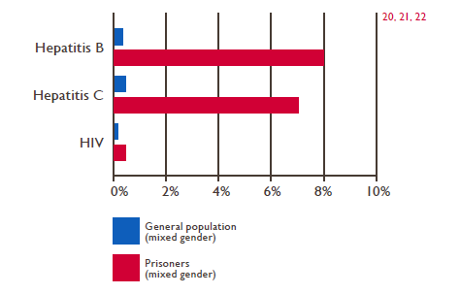
Prisons - and for blood-borne diseases
Many prison populations have high prevalence of infection with blood-borne viruses (BBVs) (Hepatitis B & C) and HIV due to large numbers of injecting drug users among incarcerated populations;
Some evidence of onward transmission of infection in some European states due to injecting of drugs, tattooing and unprotected sexual activity - although definitive data is difficult to find.
Notes:
Injection of drugs in the absence of sterile needles & syringes
Sharing other injection equipment (water, spoons, etc.) and razors, toothbrushes
Safety of medical equipment (dental, medical, gynecological)
Tattooing, piercing, scarifications, brother blood sharing rituals
Unprotected sexual relations: voluntary (circumstances), prostitution, rapes

Slide 17
Drugs and drug use
Drug use and risk behaviour often continue inside prison → high risk of infectious diseases
Drugs services in prisons are sometimes poorly developed
Overdose deaths is a general problem in most countries, especially where there is no substitution treatment available in prisons
Notes:
The initial post-release period presents ex-prisoners with a significantly heightened risk of acute drug-related mortality. Many have detoxified whilst in prison – either via healthcare or alone – so their tolerance is altered. The consequences of returning and using the same amount of drugs can prove fatal.
While prisoners during imprisonment have a mortality rate comparable with the general population this rate increases up to 50 times in the period just after release.

Slide 18
HIV prevalence (%) in selected countries
Notes:
Authorities in the Russian Federation reported a steady increase in the prevalence of HIV infection in the overall prison population from 1.2% in 2007 to 1.7% in 2009. According to sentinel surveillance in Tajikistan, the HIV prevalence among prisoners exceeded 8% in 2007. In 2009, the Republic of Moldova reported an HIV prevalence rate of 3.5% among the incarcerated population.
High rates in prisoners have been reported in some western European countries as well, such as Portugal (11% in 2000).
In contrast, other western European countries introduced successful prevention interventions targeting IDU early in the epidemics. Due in part to these interventions, HIV prevalence rates among prisoners in western Europe are typically less than 1%. In most countries, HIV prevalence in female prisoners is even higher than in male prisoners.
HIV prevalence in female prisoners almost always higher than in male prisoners.

Slide 19
Mental health and justice system
Mental health “a state of wellbeing in which every individual realises his or her own potential, can cope with the normal stresses of life, can work productively and fruitfully, and is able to make a contribution to her or his community”
Promotion of mental health
Prevention of mental ill-health and suicide
Improving the lives of people living with mental illness

Slide 20
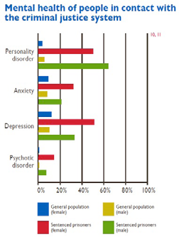
Key challenges - England
mental health needs are often complex, with comorbidity the norm
72% of men and 71% of women suffered from two or more mental disorders (including personality disorder, psychosis, neurosis, alcohol misuse and drug dependence), and 20% suffered from four
Concurrent mental health and substance misuse problems can lead to difficulties in accessing support from both health and social care
In a study of offenders on probation, 72% of those with a mental illness also had a substance misuse problem

Slide 21
Strategy to address challenge
work to reduce premature mortality from preventable or treatable illnesses
mental health
excessive alcohol consumption
smoking
sexually transmitted disease and other communicable diseases
• continue to improve the therapeutic management and treatment of problematic and dependent drug and alcohol users in prisons

Slide 22
Strategy - continued
work to reduce reoffending and create safer communities, which will have health benefits for the wider population
support partnership working
advocate a public health approach to violent crime prevention drawing on the economic and social costs of violence
provide information that supports initiatives to address the wider determinants of health
targeted initiatives that improve the health and wellbeing of offenders in the community and prisons

Slide 23
Strategy …. continued
• collaborate with NHS England and other commissioners to improve commissioning and health outcomes
strengthening pathways between custody and the community, in particular improving substance misuse / detoxification provision
collecting evidence / knowledge / data case studies

Slide 24
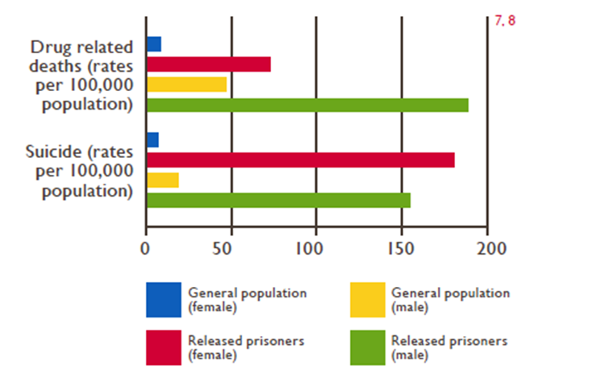
Suicide
Suicide rates are higher in prison populations than among peers in the community.
WHO data shows a suicide rate which ranges from 0 (0.0%) to almost 300 (0.3%) per 100,000 prisoners, with an average of about 60 (0.06%) per 100,000 in the 47 WHO European Member States that belong to the Council of Europe.
Data from the UK is shown as an example.
Notes:
It goes without saying that suicide rates are higher in the prison population than their counterparts in the community.

Slide 25
Harris review
Self inflicted deaths in custody of 18 – 24 year olds
Environments – bleak and demoralising
Damaging to developing young adults
Time spent in a constructive and valuable way
Need to address physical and mental health needs
A new statement on the purpose of prison
Parity of health services

Slide 26
Things happening
Prisoner volunteer programme
Liaison and diversion

Slide 27
Irish Red Cross - Prisoner Volunteer Programme
Theme of prisoner empowerment
Ireland is the first country in the world to introduce Community Based Health and First Aid in Action through groups of special status : Irish Red Cross Volunteer Inmates in a prison setting
It first began at Wheatfield Prison in 2009 and following the success of this pilot it was extended to ten prisons by 2013 and to all fourteen prisons in Ireland in 2014
The programme, which has recruited 577 Irish Red Cross volunteer inmates since 2009, benefits over 4,000 prisoners directly every day and 12,000 indirectly including staff and the families of the prisoners
Notes:
I want to present some interesting information on peer mentoring which HIPP was exposed to at Joint WHO/IPS/PHE meeting in Irish Prison Service College, Portlaoise, October 2-3, 2014;
Some good evidence to support peer mentoring
Let’s face it….the only resources that are increasing in prisons are prisoners themselves!
Community Based Health & First Aid (CBHFA) in Action was originally designed by the International Federation of the Red Cross and Red Crescent Societies to be facilitated globally in communities in a simple and flexible way through the National Red Cross and Red Crescent Society

Slide 28
Prisoner Volunteer Programme achievements:
Personal, in-cell and prison hygiene awareness
HIV & AIDS Awareness and Anti Stigma Campaigns with voluntary HIV Rapid Testing taking place in four Prisons
Weapons Amnesty Project at Wheatfield
- The results have shown a 94% reduction in assaults with a weapon and 50% reduction in assaults.
Harm Reduction drug awareness highlighting the dangers of over-dosage when taking drugs after leaving the prison.
Volunteers facilitate Smoking Cessation Courses
Contributed to TB awareness in all prisons and in Mountjoy encouraged Mass Chest X-ray (MXU) screening with over 400 prisoners screened
Increased local awareness about Seasonal Flu and norovirus outbreaks
Hepatitis vaccinations awareness programmes
Promotion of Men’s Health Awareness;
Notes:
The programme operates under a partnership between the Irish Red Cross (IRC), Irish Prison Service (IPS) and Education Training Boards (ETB’s).
It is a unique approach to raising community health and hygiene awareness and first aid in prison communities through peer to peer education.
It has also proven to build confidence and personal capacities amongst the prisoners involved in the project
Some of their achievement have been impressive.

Slide 29
Liaison and diversion
partnership working between justice, health and social care
early, pre - sentencing assessment of mental health
alternatives to custodial services
facilitated access to mental health and social support

Slide 30
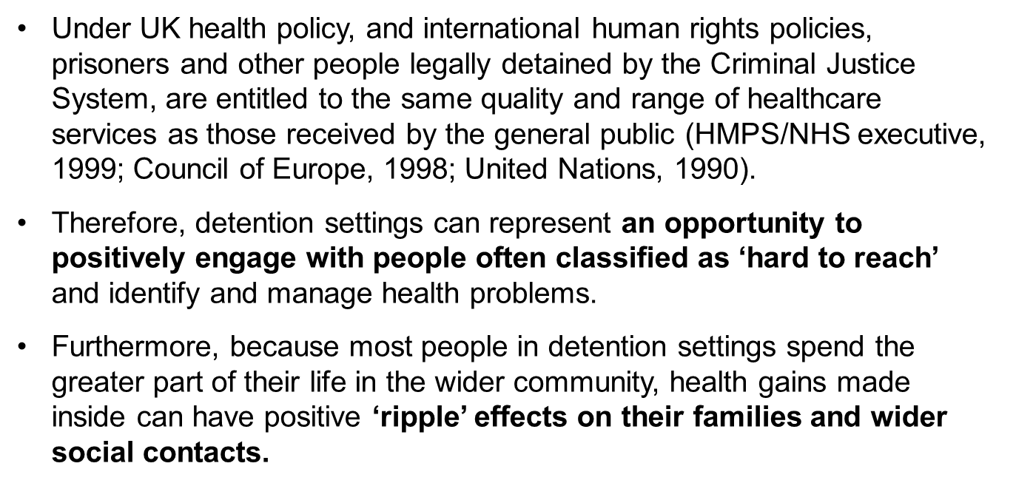
Prison & community - a health opportunity
Notes:
Recognise prison is a ‘setting’ where populations with high level of health needs are collected for variable periods of time;
Interventions can be delivered in this setting to address immediate health needs and longer term conditions;
But prison is only a ‘setting’ on a complex ‘care pathway’ through both health and justice systems;
Effectiveness of prison-based interventions will be minimised if care pathways do not extend beyond the prison walls;
Need to think about both ‘upstream’ and ‘downstream’ interventions in both health and criminal justice systems to realise health dividend for under-served populations and reduce offending/re-offending behaviours;
Need international collaboration and cooperation to gather data and ‘upscale’ interventions to detect impacts, positive and negative.
Recognise that there is the power to change - through positive engagement in prisons, ex-prisoners can become powerful peer-advocates for change among their social networks

Slide 31
Conclusions
Public health challenges associated with detention settings and community justice are significant and increasing
Prisons & other places of detention represent an opportunity to address health inequalities
The challenge is to ensure that work commenced in prisons and other detention settings is appropriately continued on return to the community
HIPP proposes a model of working in Health & Justice, where prisons are an important setting on a complex care pathway, recognising that most ‘offenders’ return to their communities
Health and Justice organisations internationally must work in ‘co-production’ mode to ensure effective design & delivery of services in prisons and beyond the prison walls.

Slide 32
Thank you
… Questions, answers and discussion

